Slide 1
Harrisonburg High School
Dare to Dream
College Graduate by 18

Slide 2
Blue Ridge Scholars Program
•Provide enrichment opportunities to academically talented students who are ready for the challenge of college coursework
•Create a pathway for students to receive an Associate Degree in Arts & Science by the end of student's’ senior year in high school

Slide 3
Junior Year Course Load
Fall
Classes at HHS
•DE BIO 101
•DE CST 110 (Speech)
•DE ENG 111 (English 11)
•DE HIS 121( U.S. History)
•DE MTH 163 (Precalculus)
or MTH 151(Liberal Arts)
•HHS Elective
Total DE Credits: 9
Summer SDV 100: 1
Spring
Classes at HHS
•DE BIO 101
•DE CST 110 (Speech)
•DE ENG 112 (English 11)
•DE HIS 122 (U.S. History)
Classes at BRCC
•DE ITE 119 (Information Literacy)
•DE MTH 157 (Statistics)
May Term at BRCC
•DE HLT/PE (Health/P.E.)
Total DE Credits: 21

Slide 4
Senior Course Load
Fall
Classes at HHS
•Chemistry
•DE BIO 102
Classes at BRCC
•DE ENG 241(English 12)
•DE PLS 235(U.S. Government)
•DE Social Behavioral Science
•DE Approved Elective
•Approved Elective or
Social/Behavioral Elective
Total DE Credits: 15
Spring
Classes at HHS
•Chemistry
•DE BIO 102
Classes at BRCC
•DE ENG 243 (English 12)
•DE Approved Elective
•DE Approved Elective or DE Social
Behavioral Elective
•DE Approved Elective
Total DE Credits: 16
Student will graduate with a total of 61 college credits.

Slide 5
Junior/Senior Mentor Program
Lets face it….this program is hard both academically, mentally, and emotionally.
After the first year of the program, it was decided that the Senior Scholars would mentor the Junior Scholars as a way to provide assistance to the Junior Scholars.
The level of mentorship varies among mentors

Slide 6
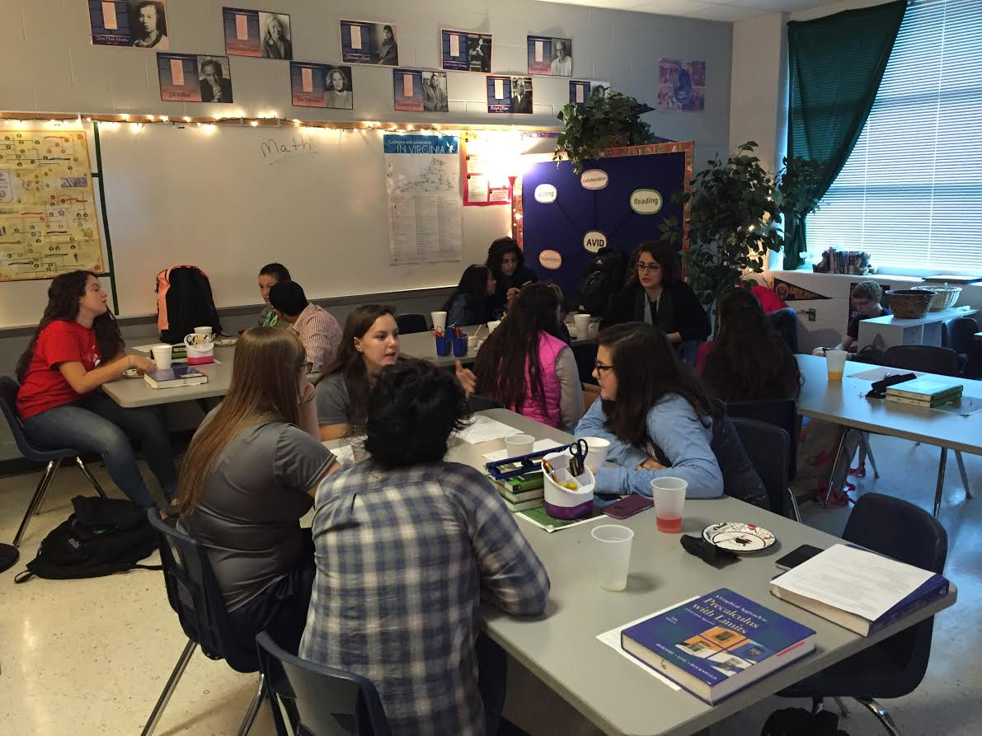
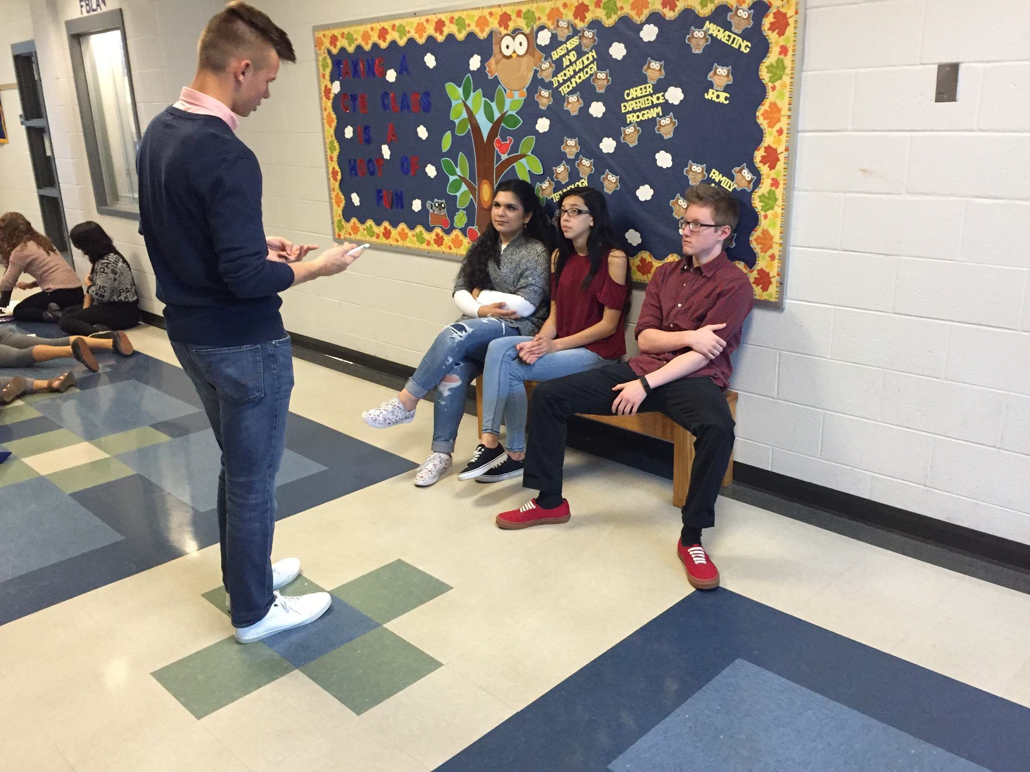
Mentoring…..

Slide 7
Cost Saving
Harrisonburg Public Schools helps with the following costs:
–Tuition
–Textbooks
–Transportation
Average cost: $400-480 per semester
Total for Associate Degree:
$1,830 @ Blue Ridge Community College
$20,780 @ James Madison University for two years
$65,180 @ Bridgewater College for two years

Slide 8
Where Are We Going…..
Two graduating classes of the program and students have transferred to:
James Madison University Bridgewater College
Virginia Tech Liberty University
Purdue George Mason
Eastern Mennonite University Christopher Newport University

Slide 9
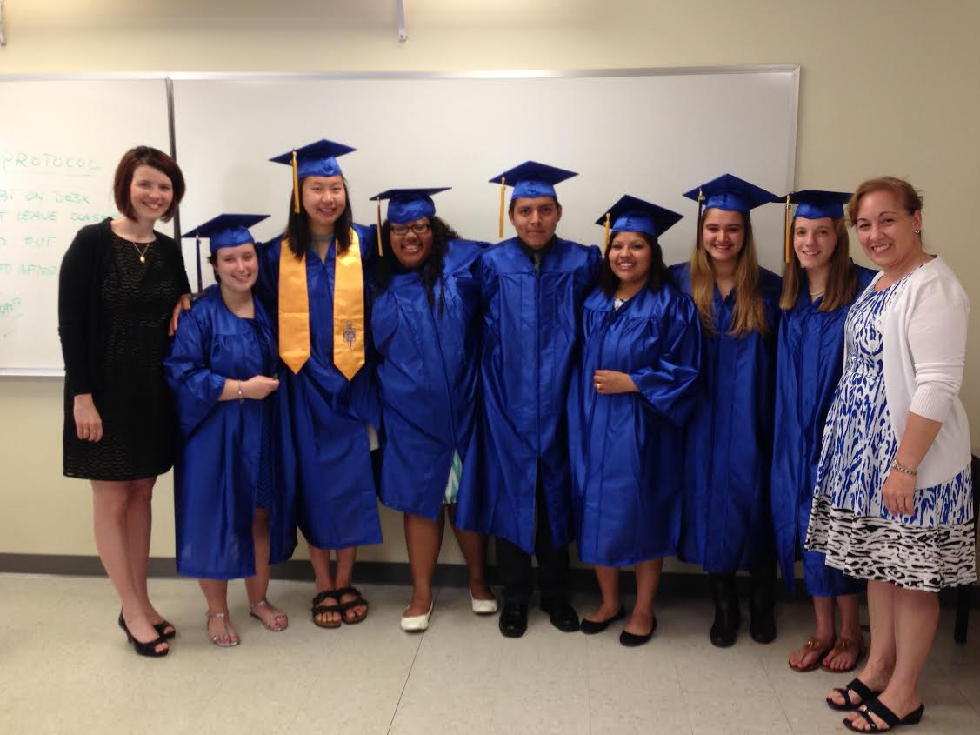
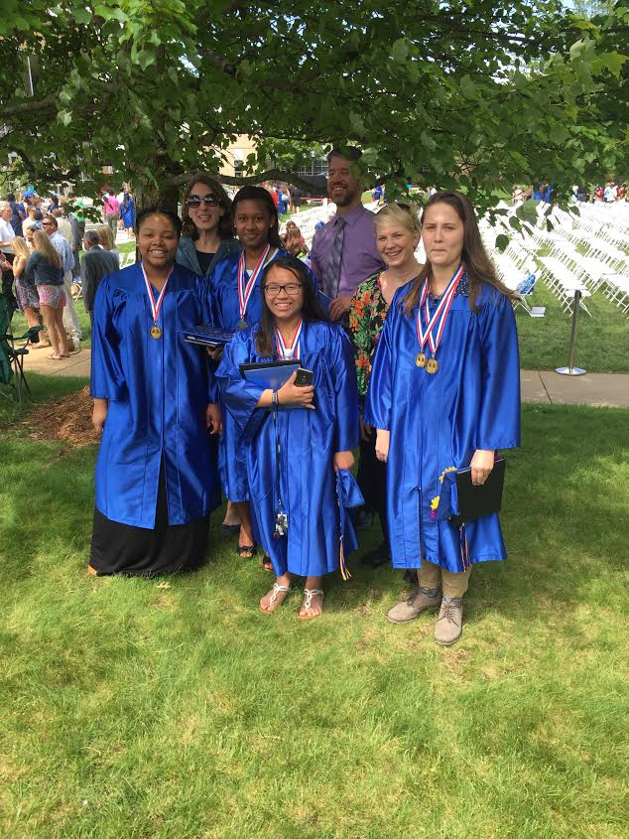
Graduating From College Before High School

Slide 10
Getting a similar program to your High School
Speak with your counselor about what dual enrollment classes are offered at your high school.
Speak with your school board and superintendent on possibilities of creating a similar program.
Contact your local community college and ask about navigating a pathway to obtains an Associate's Degree or General Studies Certificate

