Slide 1
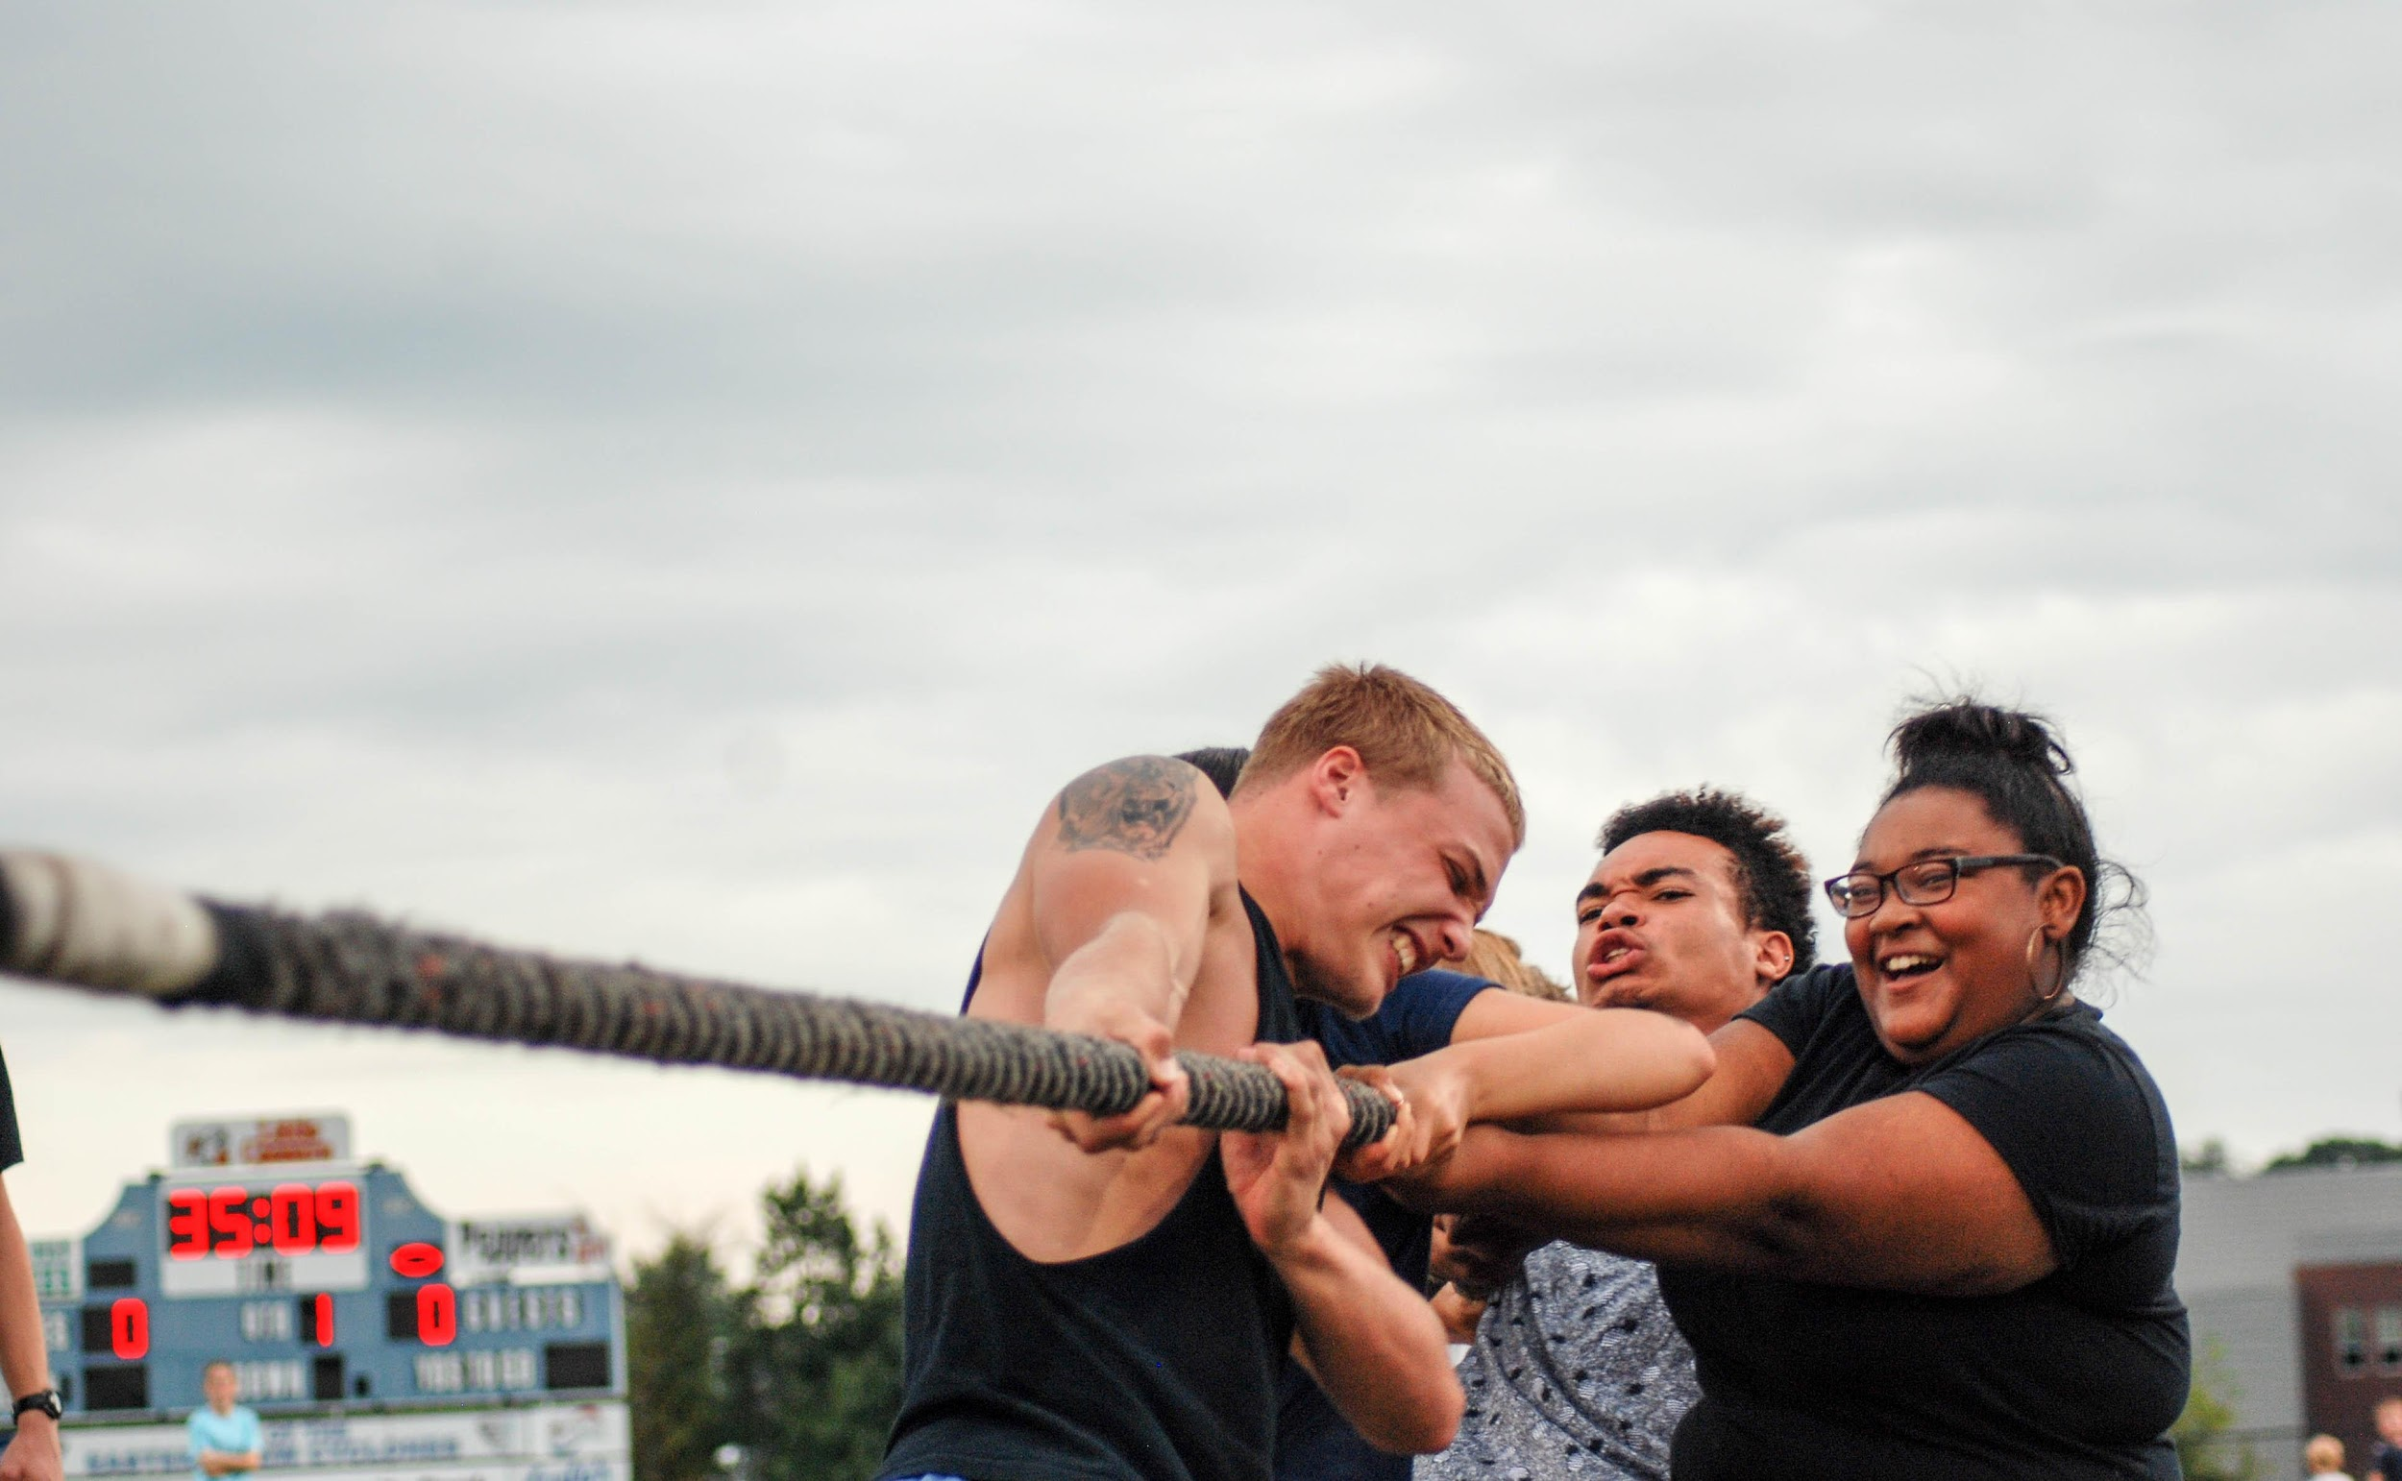
CYCLONE GAMES
Eastern View High School
Culpeper Va, 22701

Slide 2
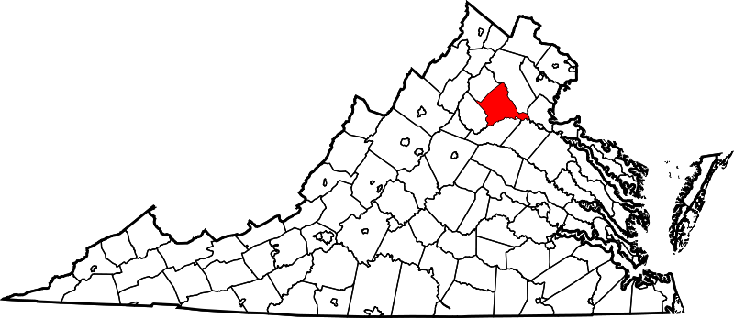
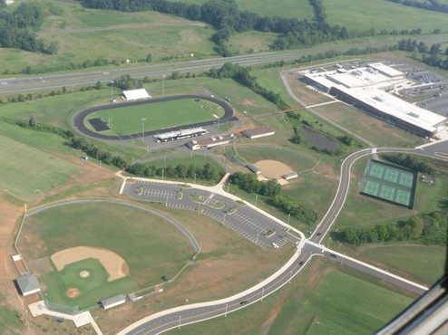
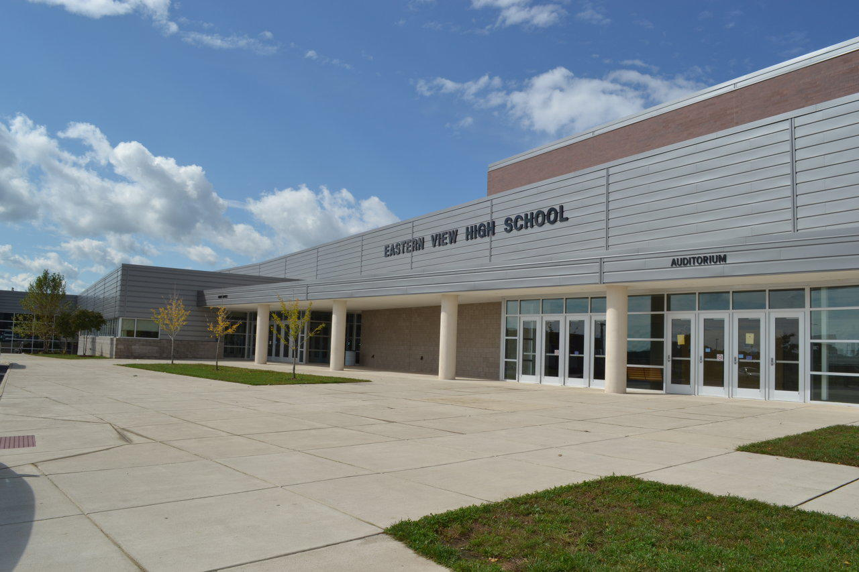
Where are you from?
Culpeper, Virginia
Sports Complex and School Building
Facts
Opened in 2008
Student Population: about 1300
Mascot: Cyclone
Battlefield District of Virginia
Principal: Mr. E.G Bradshaw
Home of the Cyclones
Notes:
T
his “front entrance” caption feels slightly odd to me. Maybe say “opened” instead of “built” in 2008.
Hannah

Slide 3
What are the “Cyclone Games”?

Slide 4
What are the Cyclone Games?
The Cyclone Games are comprised of ten old- fashioned yard games and four teams made up each grade level.
Notes:
No comma is necessary
Hannah

Slide 5
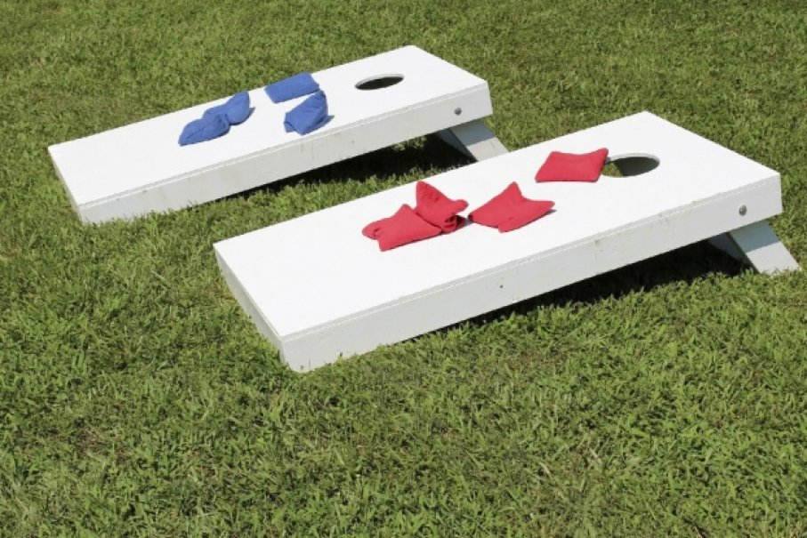
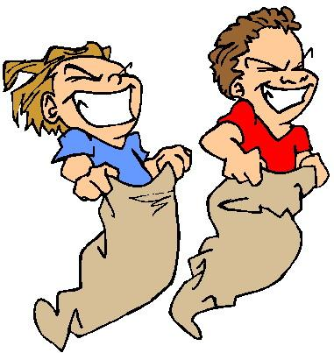
What are the Cyclone Games?
Each team has to go through the series of games, trying to win and beat out the other teams for points.
Old Fashioned Games include the following:
-Corn Hole
-Sack Race
-Tug-a-War
-Three-Leg Race
-Water Balloon Toss
-Football Free Throw
Notes:
The goal is to communicate clearly why this activity, event, or program is so successful at your school and how key elements could be incorporated into any other school.

Slide 6
What are the Cyclone Games?
Each GRADE LEVEL will have one team to represent them at each set of games.
The team (grade) with the most amount of points wins the Cyclone Games, earning themselves 5 spirit points towards the spirit stick.
And, of course, bragging rights.
Points are set up as :
Placement | Points Earned
1st Place | 5
2nd Place | 4
3rd Place | 3
4th Place | 1
Notes:
Towards winning the spirit stick (maybe explain the spirit stick? Is that necessary?), not “towards the spirit stick”
Should be “And, of course, bragging rights.”
Hannah

Slide 7
Why did we create the Cyclone Games?
Notes:
Use we instead of you?
Hannah

Slide 8
Why did we create the Cyclone Games?
This year was the first year the Cyclone Games were implemented.
We began the new tradition of the Cyclone Games because of the low attendance to the Powderpuff Games held during Homecoming week.
We thought it might be because freshmen and sophomores weren’t included in the Powderpuff Game.
Notes:
Low attendance - specifically by grade levels that don’t participate in the game (freshmen and sophomores). The final few statements feel awkard.
Hannah

Slide 9
How to have a Cyclone Games at your school?

Slide 10
How it happened?
Step 1: Get a team of students, with a group of teachers, to commit to organize the event.
Begin listing potential yard games
Maybe use SCA, Class Officers, or just a selected group of responsible individuals.
Don’t forget to name your games!
Notes:
Use group, not few
Hannah

Slide 11
How it happened?
Step 2:Permission
Before you can do anything, ask for permission from your school principal
Present him with a proposal with a description of the games
Include date, time, games, place, costs, safety, materials, and any favors needed from the school
Be prepared for any questions or concerns
Once granted permission, begin planning at once.

Slide 12
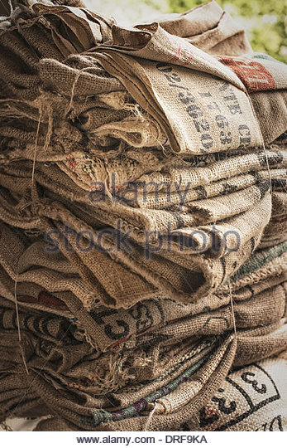
How it happened?
Step 3: Plan Accordingly
Finalize your yard game list
Begin preparing at least a month in advance.
Begin collecting all the materials needed
Borrow from the P.E department, local businesses, or parents.

Slide 13
How it happened?
Step 4: Have sign-ups for teams to play each set of games.
Have each grade’s class officers be in charge of signing students up for the games.
Make sure they know that they need a different team set for each game to allow as many students to participate.
Use SOCIAL MEDIA to spread the word of the games and remind students to sign up.
Allow at least 2 weeks for students to sign up.

Slide 14
How it happened?
Step 5: Execute
Double-check that everything and everyone knows what they are doing
Make sure to announce the games are for spirit points
Take pictures and videos!
Update on social media score boards
After all is done, write your thank you cards to everyone who helped.

Slide 15
So what were the results?

Slide 16
Our Results
With the inclusion of freshman and sophomores in addition to juniors and seniors, not only did attendance increase, but school spirit was strengthened.
It brought a lot of rivalry between the classes, making them want to participate more in spirit week.
And with the results we saw, it was a success.
Notes:
“Increased” should actually be in present tense
Hannah

Slide 17
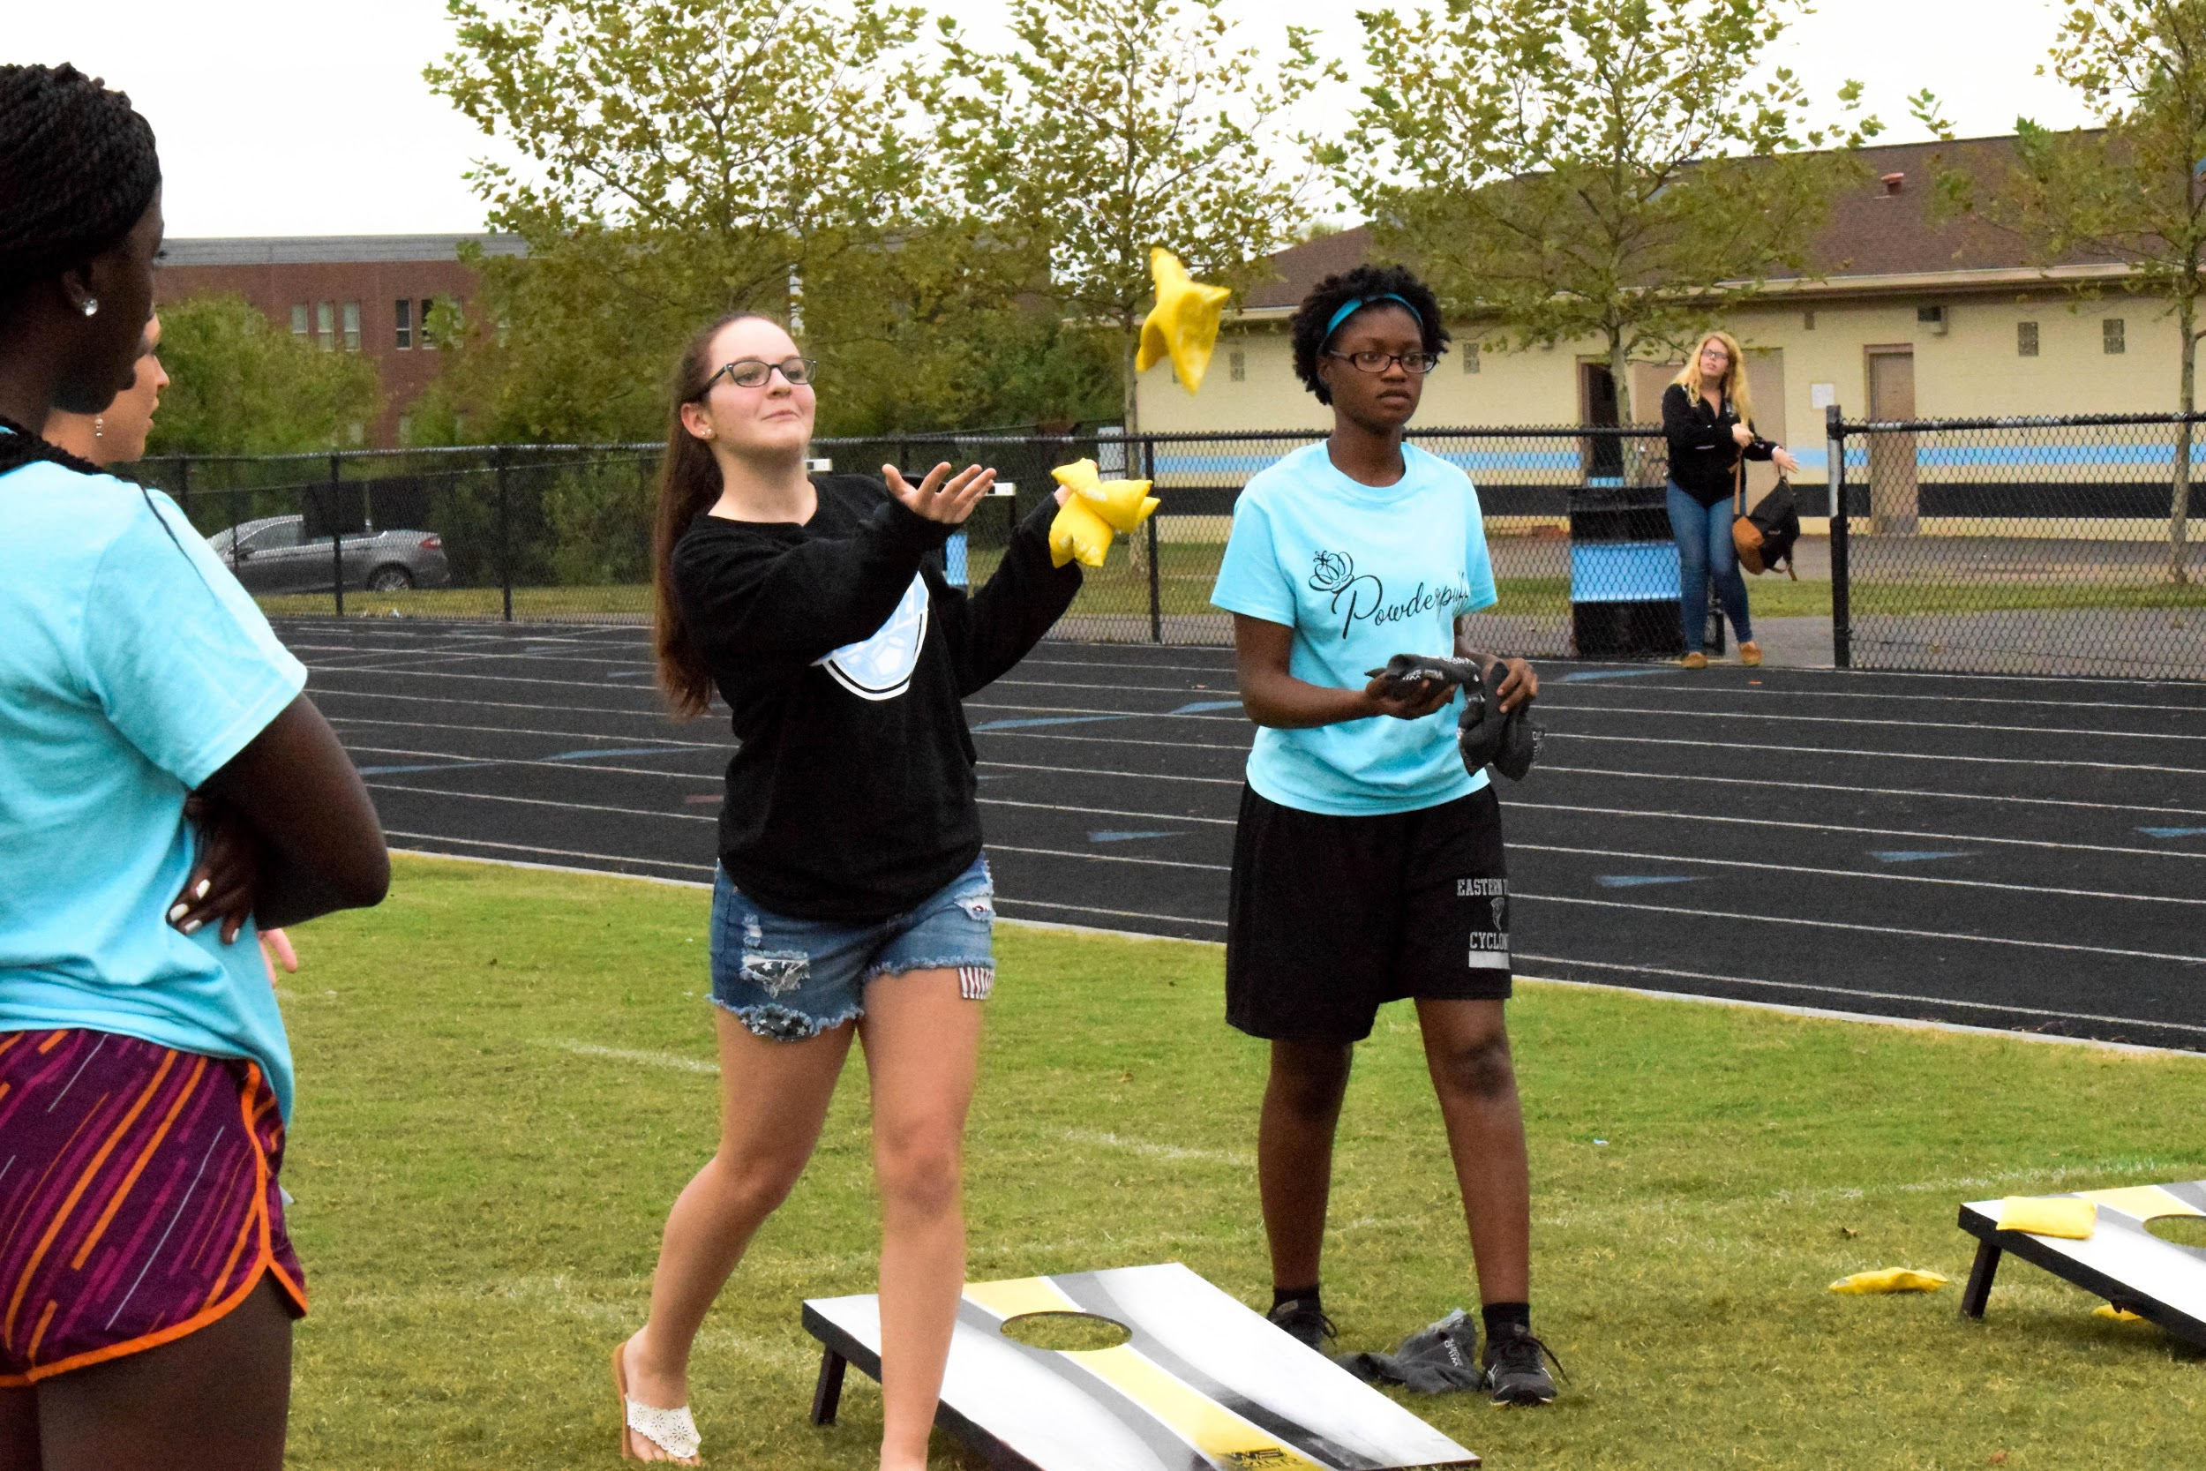
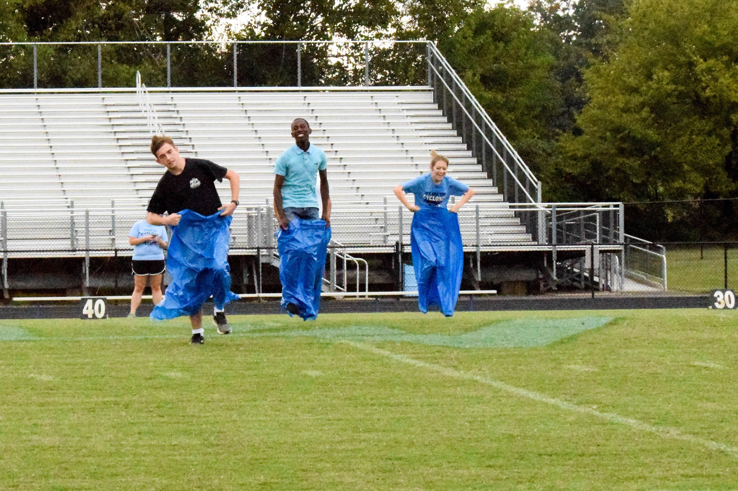
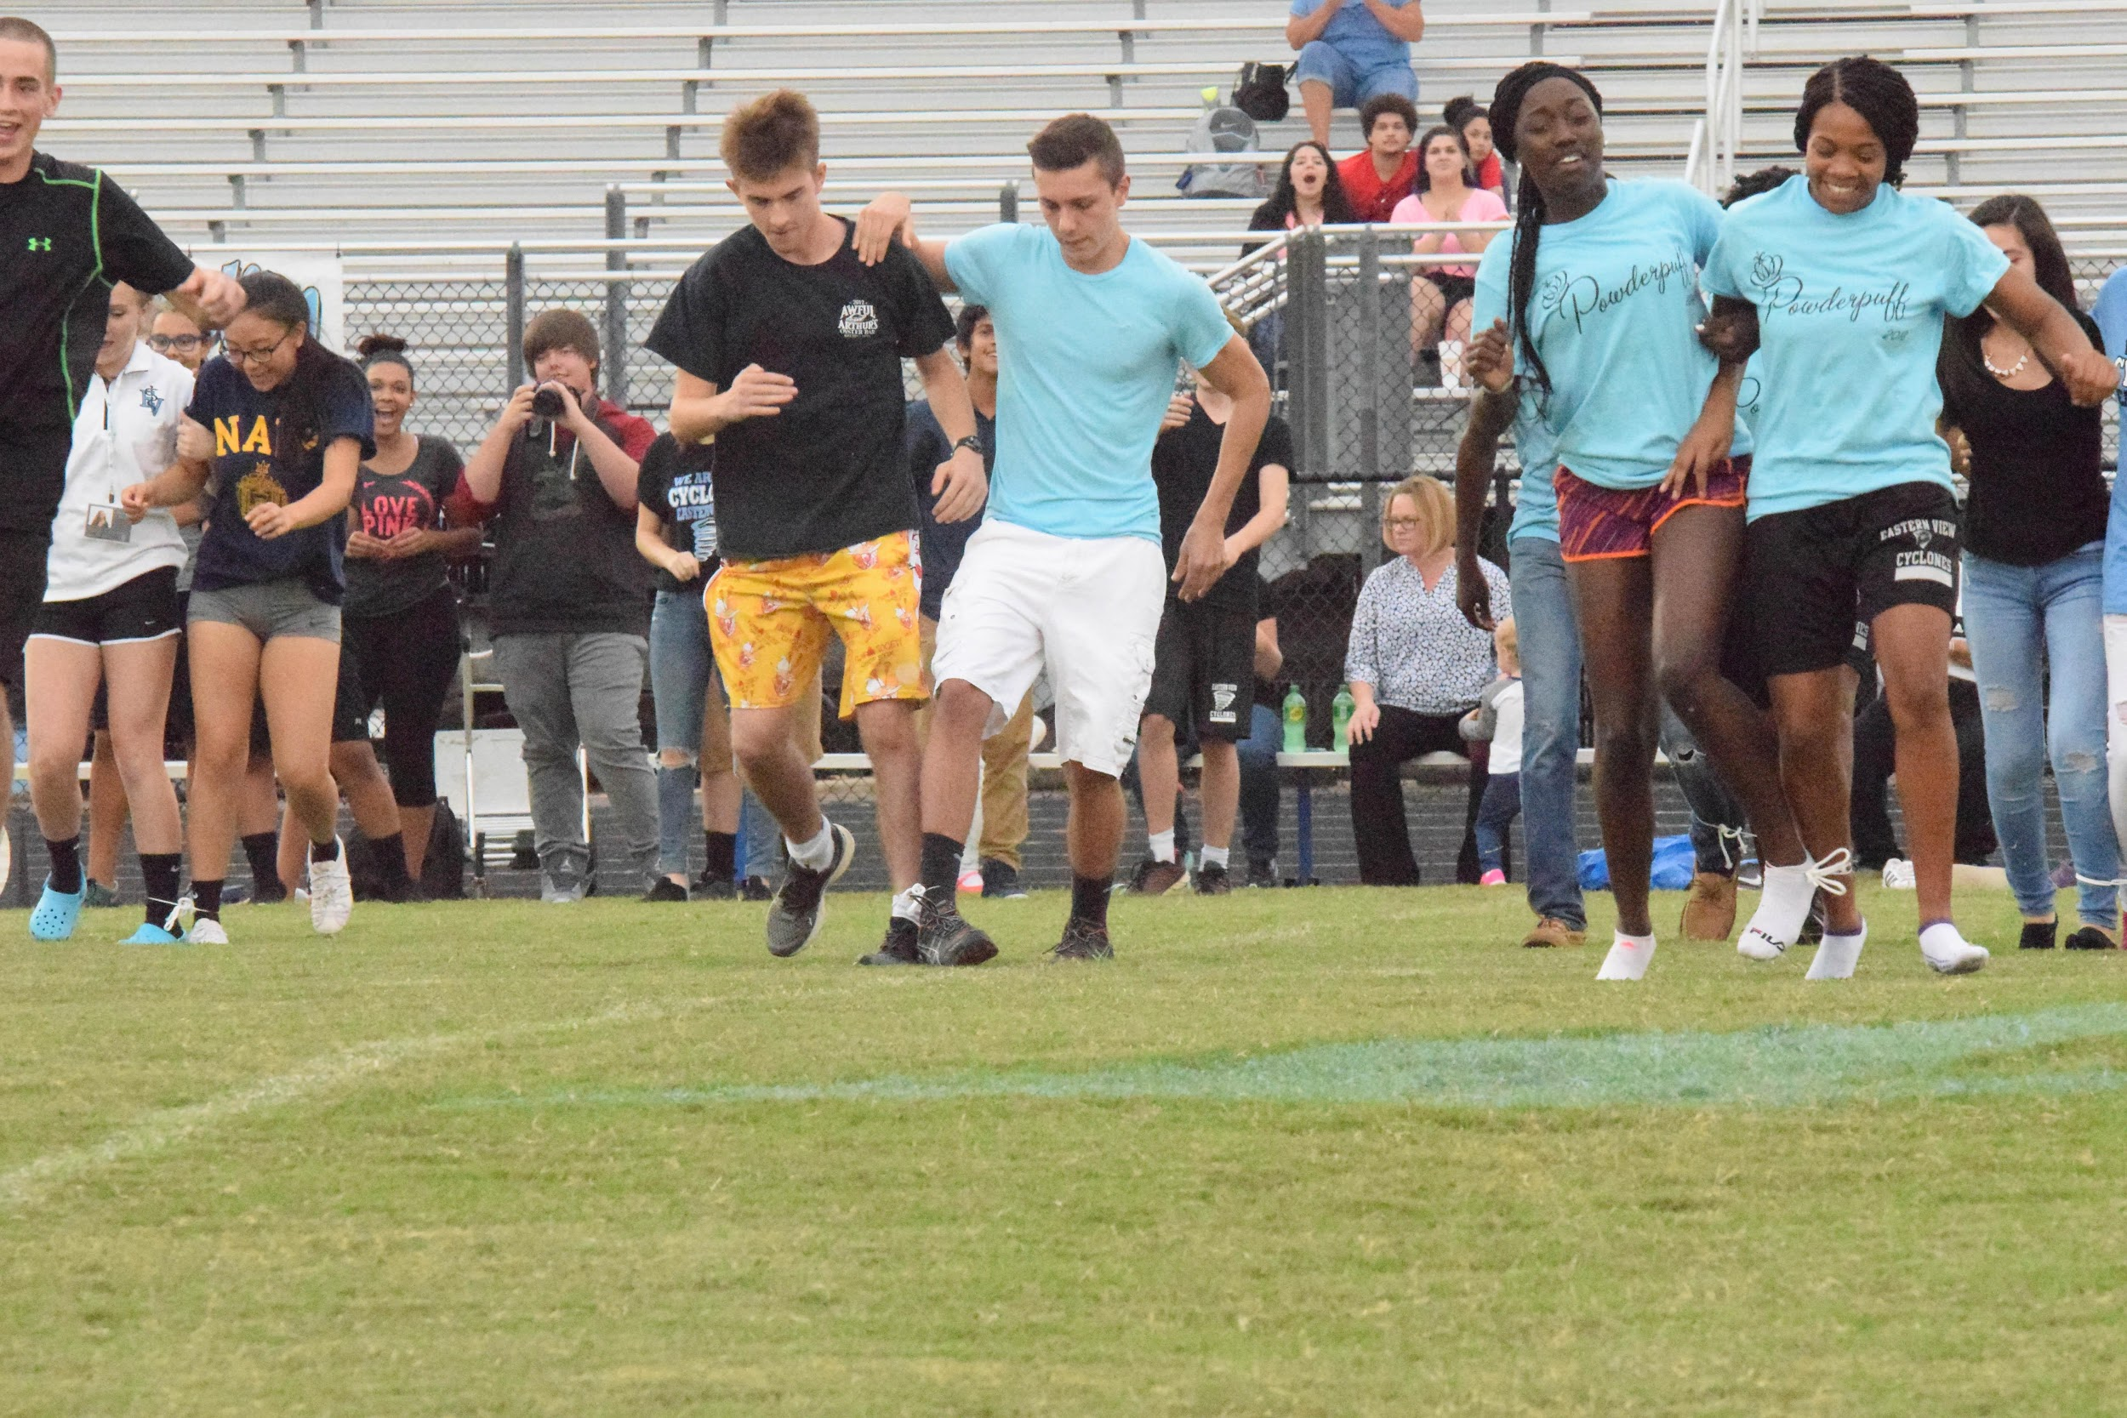
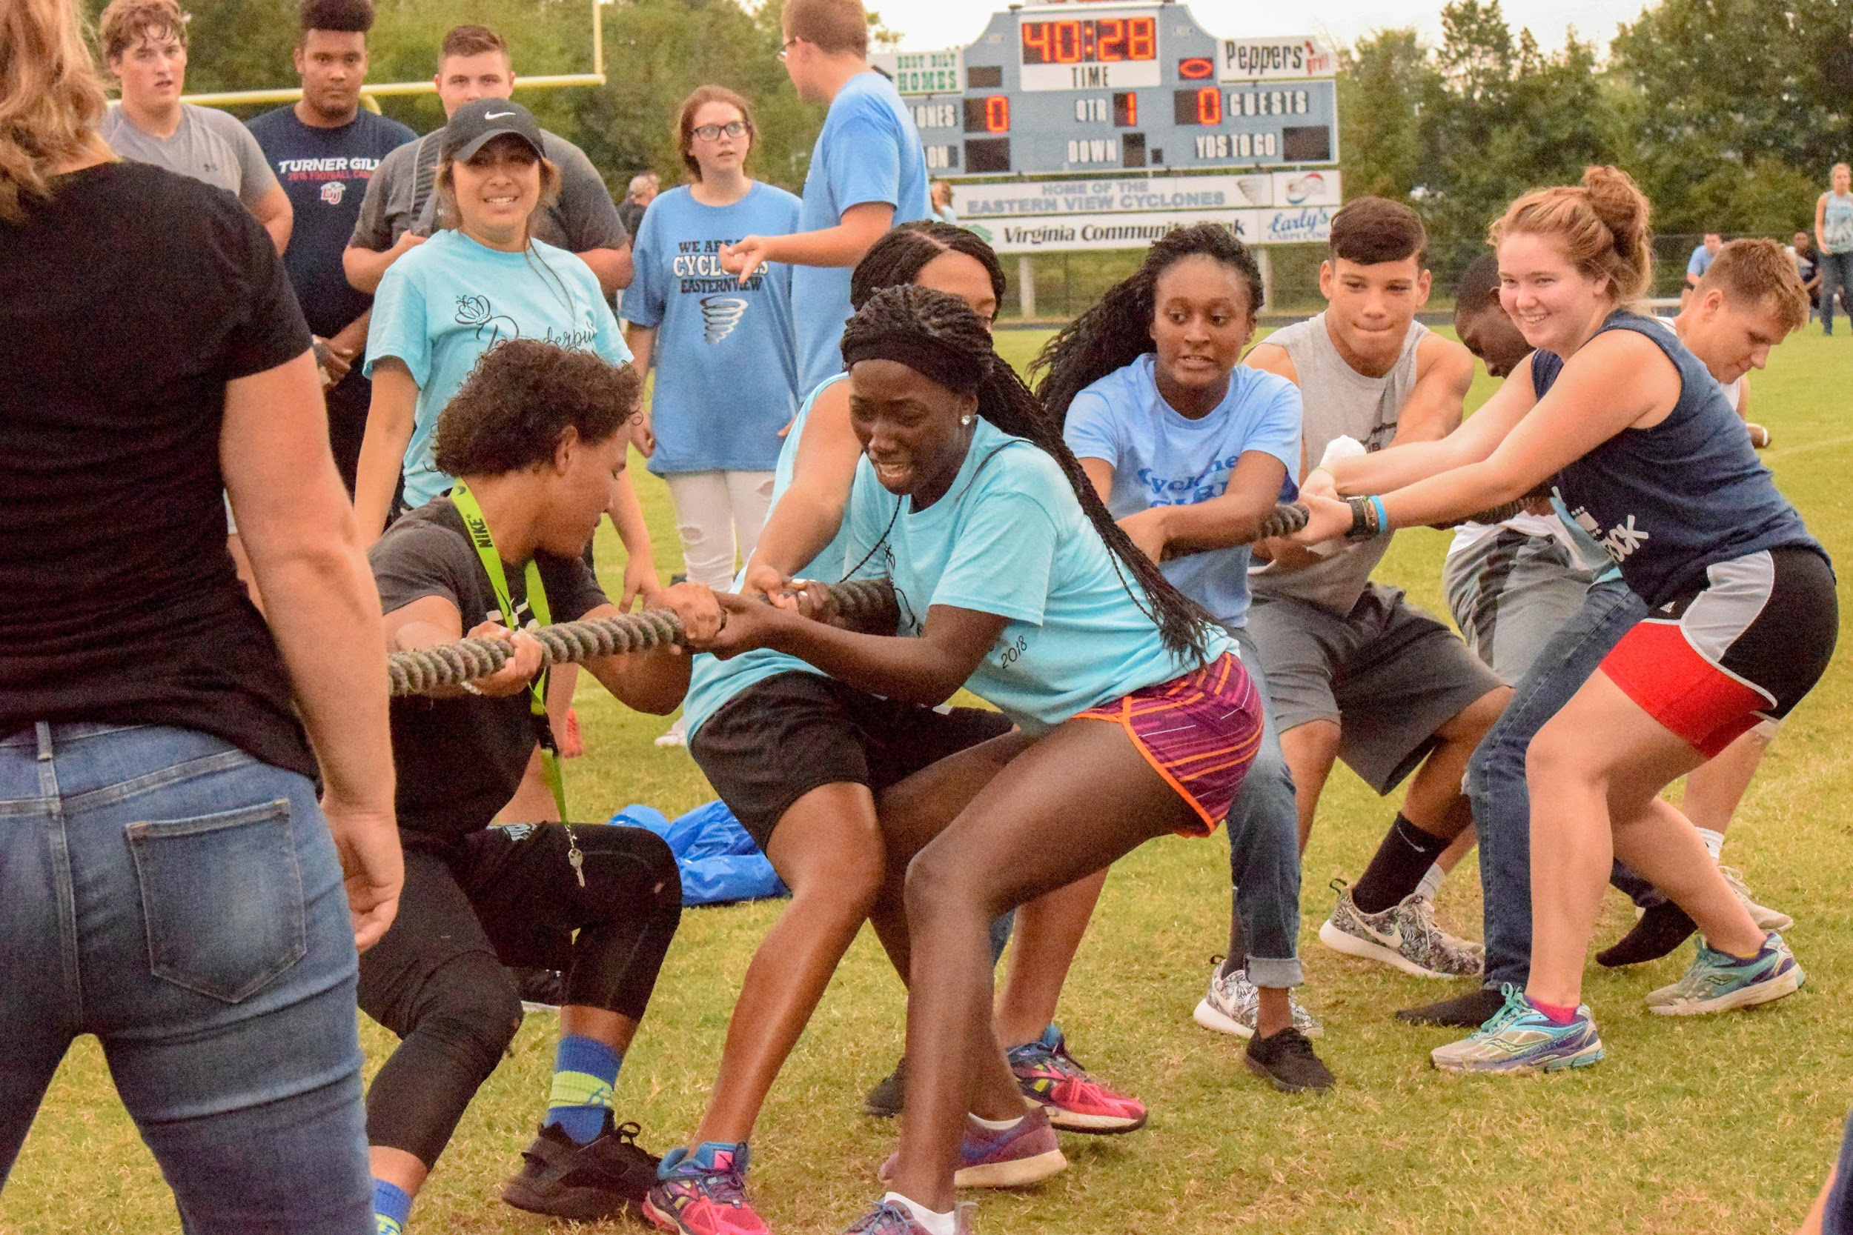
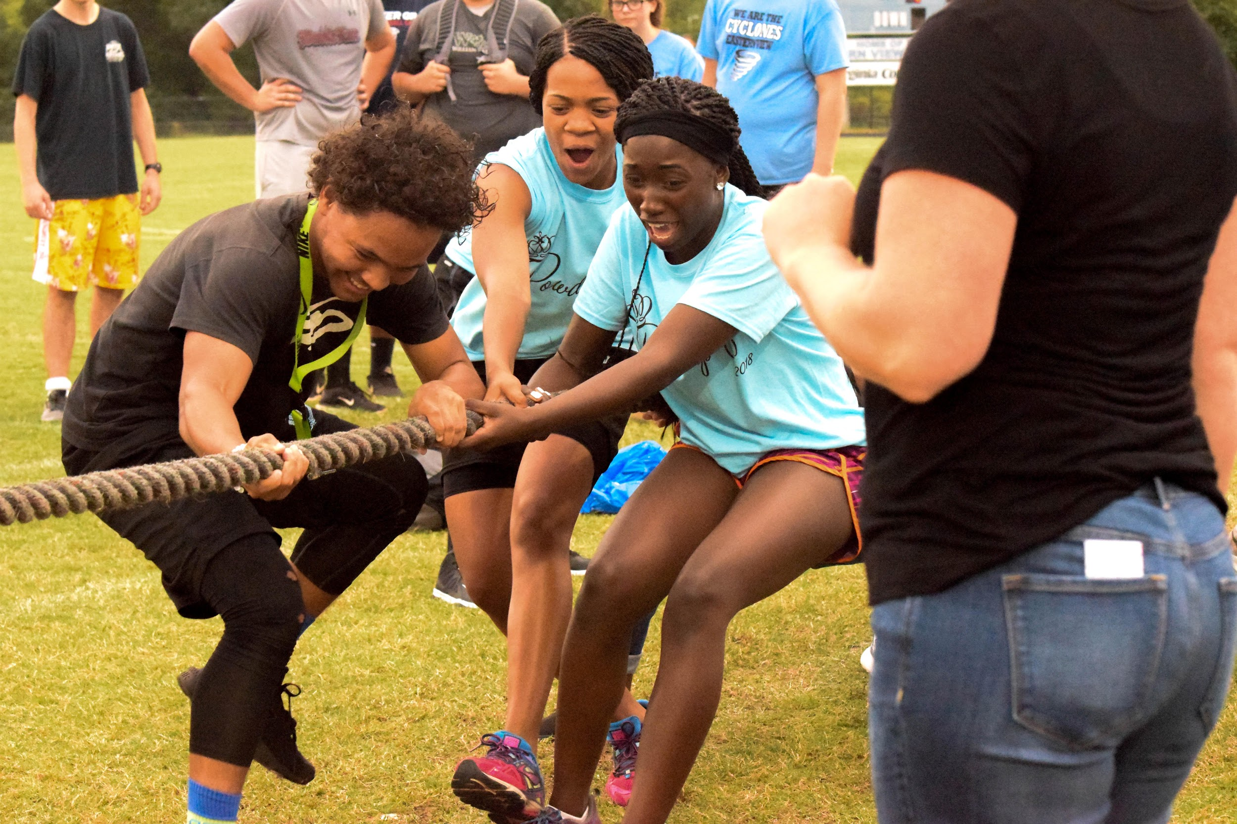
See for yourself...
Notes:
Is there any way we could use a different picture from the bottom right one? We already used that on the opening slide.
Hannah

Slide 18
Good Luck with your school’s own Spirit Games!
Notes:
Is there any way we could call it something other than the Cyclone Games on this slide? The other schools will obviously not have “Cyclone Games” because that’s our own mascot.
Hannah

